Slide 1

ENTERPRISE NETWORK DESIGN
FINAL PROJECT
HOGWARTS NETWORK DESIGN
INSTRUCTOR – PROF. LUIS RIVERA
BY:
SAI RAJESH KORLAM JOSHITHA GUNREDDY
VIHARI KORALLA
DARSHINI PATEL

Slide 2
BASIC NETWORK OUTLOOK
HOGWARTS
GRYFFINDOR
RAVENCLAW
SLYTHERIN
HUFFLEPUFF

Slide 3
Introduction:
Campus Name: HOGWARTS
Domain name: www.Hogwarts.edu Hogwarts is a university in New York with three branches in West Haven, India and Austin.
Hogwarts has a total of 15000 users including students, staffs, management and Admins.
Hogwarts network was made end to end setup to organize various operations on campus.

Slide 4


The data in campus is huge and some of them is confidential, the database server is running 24 hours, by accidentally if there is any failure in the network system, this leads to huge data loss.
Backup server is used in case of any accidental loss of data which is located in Data center.
Network security is highly important.

Slide 5
Business goals
Adequate opportunities for faculty and staff
Increase revenue sources
Advance technological operations
Secured and reliable services
Prevent and mitigate unauthorized activities

Slide 6
Technical goals:
Network security for authorize user
Multi campus services
Enhance network performance
Support both on campus and remote users
High network availability
Flexible and intruder free environment

Slide 7
Ip addresses
Subnet/VLAN for West Haven (GRYFFINDOR)
Description | VLAN ID | Network/IP Range
Admin | 100 | 172.16.80.1 – 172.16.87.254
Students | 200 | 172.16.88.1 – 172.16.95.254
Labs | 300 | 172.16.96.1 – 172.16.103.254
Office | 400 | 172.16.104.1 – 172.16.111.254
Subnet/VLAN for India ( SLYTHERIN)
Description | VLAN ID | Network/IP Range
Admin | 100 | 172.17.16.1 – 172.17.23.254
Students | 300 | 172.17.32.1 – 172.17.39.254
Office | 200 | 172.17.24.1 – 172.17.31.254
Labs | 400 | 172.17.40.1 – 172.17.47.254
Subnet/VLAN for New York (Head Quarters)
Description | VLAN ID | Network/IP Range
Admin | 550 | 172.18.56.1 – 172.18.63.254
Students | 510 | 172.18.24.1 – 172.18.31.254
Finance | 520 | 172.18.32.1 – 172.18.39.254
Management | 530 | 172.18.40.1 – 172.18.47.254
Office | 540 | 172.18.48.1 – 172.18.55.254
Library | 560 | 172.18.64.1 – 172.18.71.254
Labs | 500 | 172.18.16.1 – 172.18.23.254
Research | 570 | 172.18.72.1 – 172.18.79.254

Slide 8
Frame Relay
Frame relay is a packet switching technology
In frame relay the router are called DTE (Data terminal equipments), which means the router is ultimate source or destination of the traffic.
All these routers are connected to service provider through serial connection called access link.
This works as a shared network and do not need point to point circuit between every single router.
The bandwidth is shared between all these routers
Frame Relay sends information in packets called frames through a shared Frame-Relay network. Each frame contains all the information necessary to route it to the correct destination.

Slide 9
Advantages and Disadvantages
An advantage of frame relay is that is often cheaper than dedicated lines. It is easy to redesign and optimize the network because changing port connection and virtual circuit bandwidth is software configurable.
Fewer circuits and less hardware
Cost effective
Disadvantages of frame relay include possible traffic jams.

Slide 10
Network applications
Library/Catalog
Web Search
File Management System
Virtual Labs
Online Classes
Distance Learning Site
Email application

Slide 11
Servers
DNS Server
Web Server
FTP
TFTP
Email
Syslog
NTP

Slide 12
Network Topology
Network topology is the way of laying out the network.
Physical topology: It is about the arrangement of nodes in the networks.
Bus
Star
Ring
Partial Mesh
Hybrid

Slide 13
Bus topology
A Bus topology in which all nodes connect to the network via a central cable called the bus.
The bus acts as the shared communication medium that the devices are attached to.
Any device that wants to communicate with other device on the network will send its data over the bus which will be send to all attached devices but the intended recipient will only process that packet.
Thus bus topology is good and easy to setup for only a small number of devices.
As devices and network utilization increases the performance issues and problems arise.
If the bus is damaged then the whole network fails making bus topology a less preferred option.

Slide 14
Ring Topology
A ring topology is a network configuration in which device connections create a circular data path.
Each networked device is connected to two others, like points on a circle. Together, devices in a ring topology are referred to as a ring network.
In a ring network, packets of data travel from one device to the next until they reach their destination.
Most ring topologies allow packets to travel only in one direction, called a unidirectional ring network. Others permit data to move in either direction, called bidirectional.
The major disadvantage of a ring topology is that if any individual connection in the ring is broken, the entire network is affected.

Slide 15
Star Topology
It is the most common topology and is the widely implemented.
In a Star Topology every device is connected to a central device such as a switch.
Star topology requires more cable but it mode robust as a failure in one cable will only disconnect the specific connected computer via that cable to the central device.
The messages between systems will always flow via the central device and so if the central device fails the entire network will fail.
Star topology is very easy install, manage and troubleshoot making it the most common topology in home and office networks

Slide 16
Partial Mesh Topology
A WAN could also be developed with a partial mesh topology.
Partial meshes are highly flexible topologies that can take a variety of very different configurations.
The best way to describe a partial mesh topology is that the routers are much more tightly coupled than in any of the basic topologies but are not fully interconnected.
Partial meshes offer the capability to minimize hops for the bulk of the WAN's users.

Slide 17
Hybrid Topology
A hybrid topology is a type of network topology that uses two or more differing network topologies.
These topologies include a mix of bus topology, mesh topology, ring topology, star topology, and mesh topology.
For our network, we have used the combination of bus, star and partial mesh topology.

Slide 18
EIGRP
EIGRP is the acronym for Enhanced Interior Gateway Routing Protocol.
Initially, it is a proprietary protocol designed by Cisco Systems which is available only for the Cisco routers and is later converted to an open standard in 2013 and got an informational status as RFC 7868 in 2016.
IGRP has been replaced with EIGRP since IGRP was not able to support the classless IPv4 addresses.
The main advantage of EIGRP over RIP is that it reduces the workload on the router by sending only the incremental updates.

Slide 19
ADVANTAGES
Some of the many advantages of EIGRP are:
Network resources are used very less during normal operation.
When a change occurs, only the incremental changes in the routing table are propagated but not the entire routing table.
This reduces the load the on the entire network.
convergence time is very low , we can say it is instant.
EIGRP is an enhanced distance vector protocol which works on the Diffused Update Algorithm (DUAL) to calculate the shortest path for the propagation of the table.

Slide 20
METRICS
EIGRP calculates the total metric by measuring the bandwidth and delay metrics.
EIGRP uses the following formula to scale the bandwidth:
bandwidth = (10000000/bandwidth(i)) * 256
bandwidth(i) = least bandwidth of all outgoing interfaces on the route in kilobits
EIGRP uses the following formula to scale the delay:
delay = delay(i) * 256
delay(i) = sum of the delays configured on the interfaces to the destination network measured tens of microseconds.

Slide 21
Security
Firewalls
Access control list
Syslog server
TFTP
Passwords
Encryption
VPN
Backup servers

Slide 22
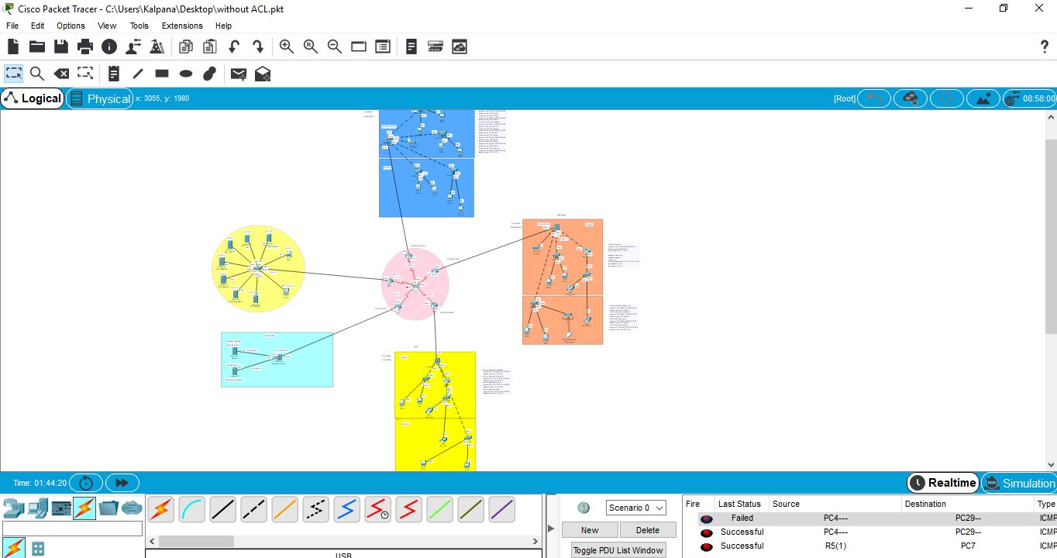
OVERALL NETWORK

Slide 23
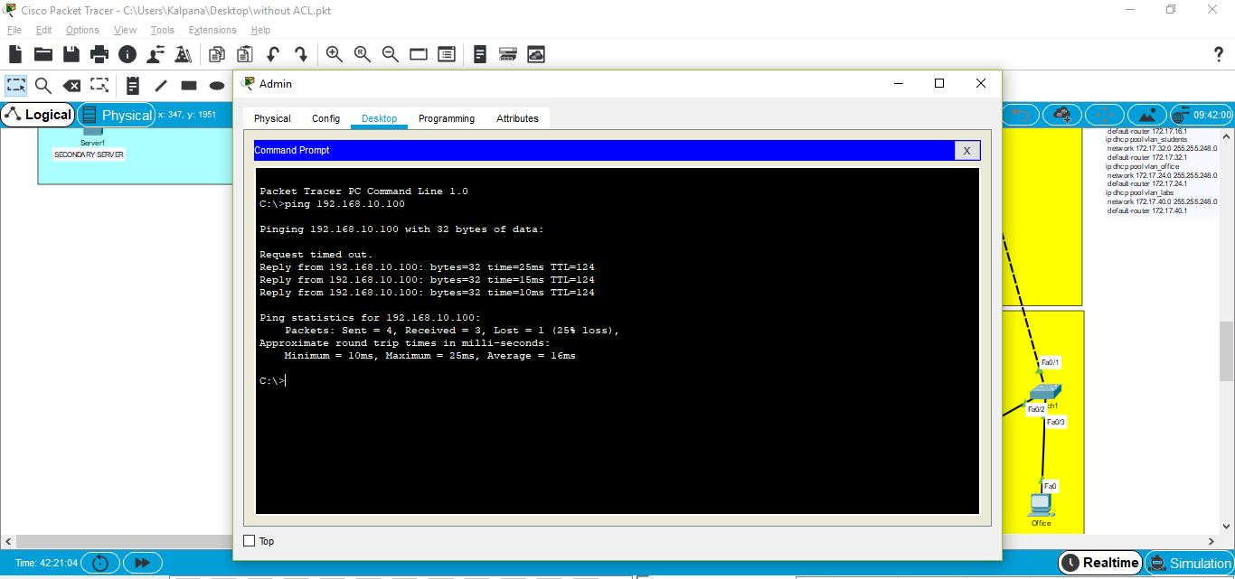
ACL

Slide 24
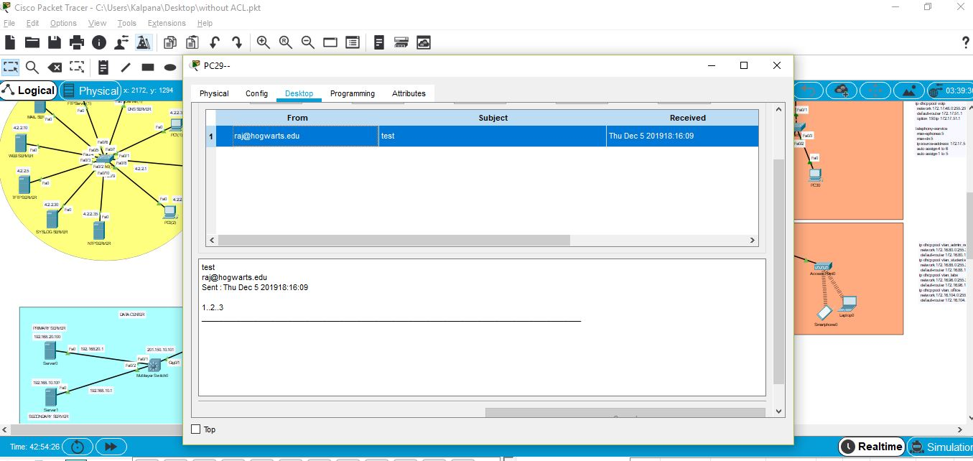
EMAIL

Slide 25
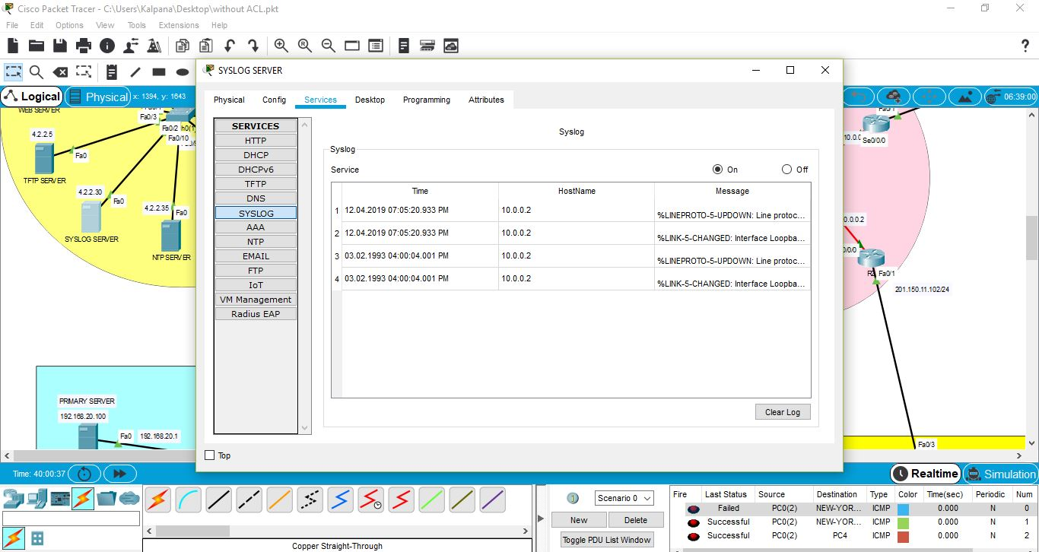
Syslog

Slide 26

THANK YOU

